Slide 1
Saving your Money
Make your money work for you

Slide 2
Types of (savings) accounts
Fixed term
Easy Access
Regular savings
ISAs and types of ISA
Investing
Current accounts
Stoozing

Slide 3
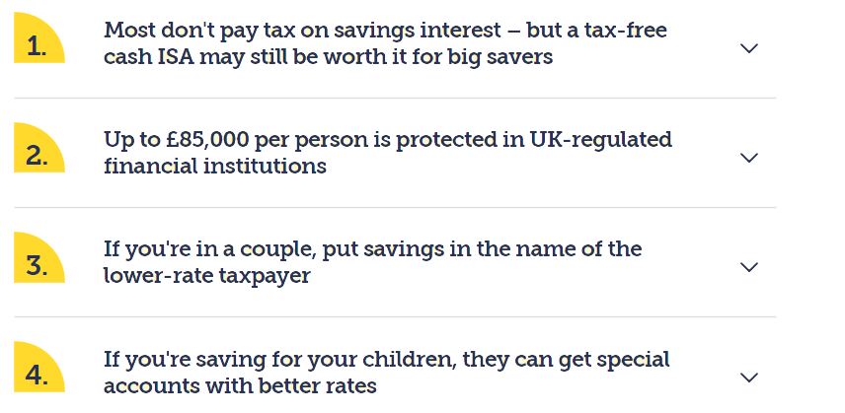
Four Quick Savings Need to Knows

Slide 4
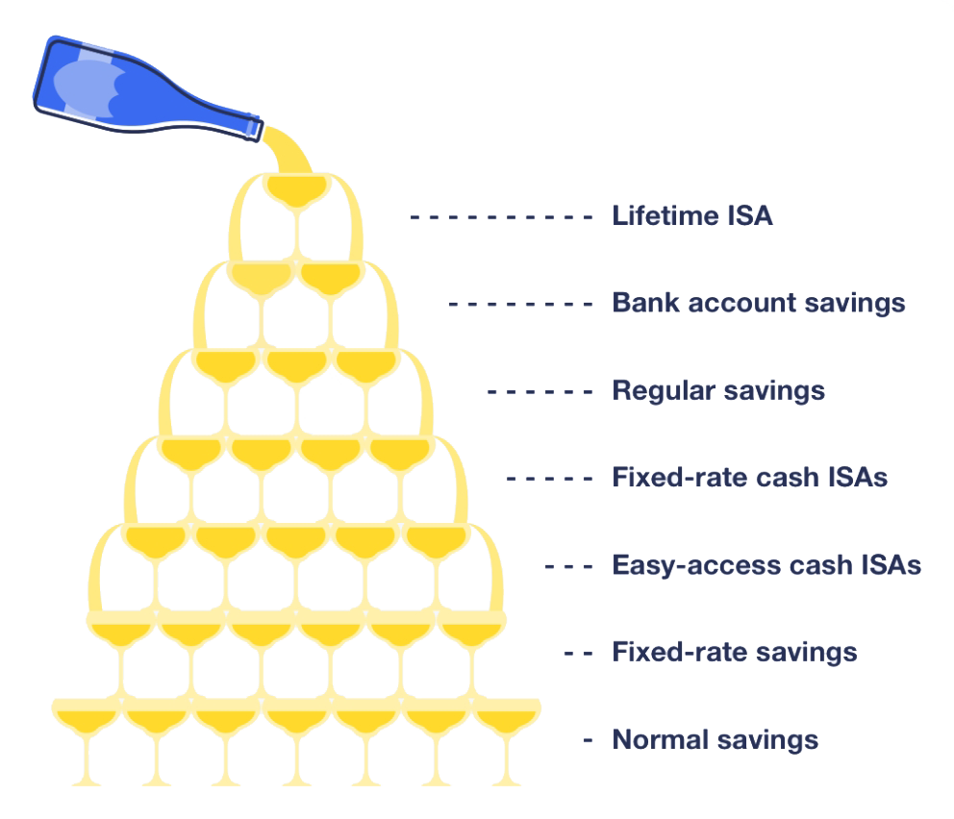
The Savings Fountain
https://www.moneysavingexpert.com/banking/savings/which-saving-account-old/

Slide 5
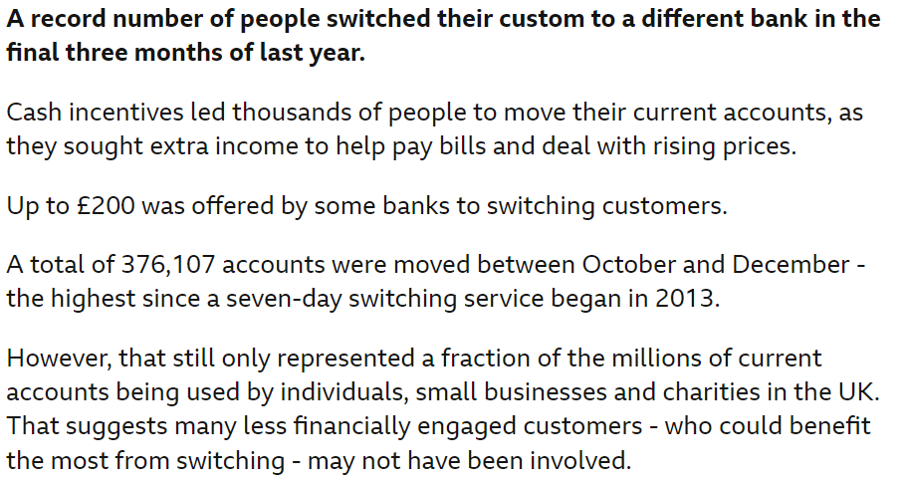
Keeping Hold of your Money
Interest rates vs current account bribes

Slide 6
Keeping Hold of your Money - all debt is bad?
Good debt vs bad debt

Slide 7
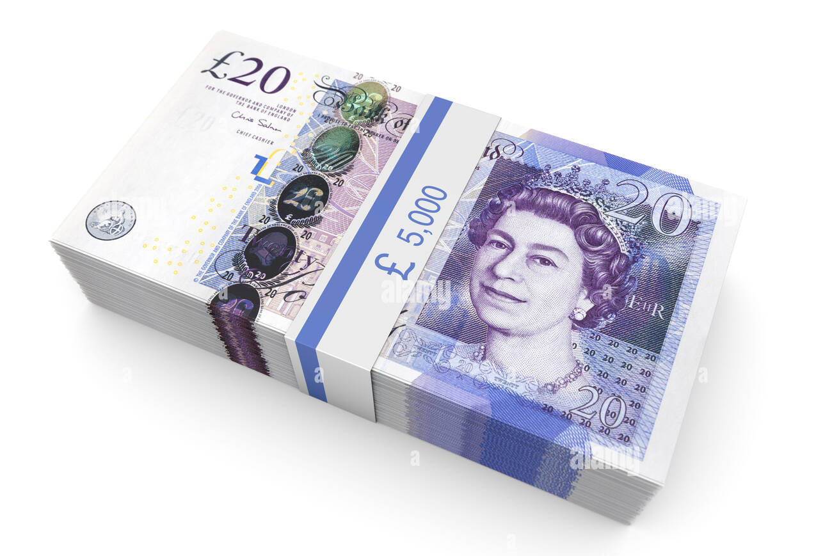

Slide 8
Saving Money - challenge…!
Make the most money possible…
£5,000
Zero-risk accounts only (i.e no stocks, investments or business start-ups. Stick to bank and savings accounts)
It must be legal!

Slide 9
This Week's Top Tips
https://www.moneysavingexpert.com/latesttip/
10th October 2023…
Free Wills Month for age 55+ every October and March
Amazon Prime Day 10-11th October
£200 + 8% regular saver at Nationwide, £175 + 7% at First Direct
5.12% on $≤$ £5k at Barclays, 4.1% on £££ at Chase
https://www.moneysavingexpert.com/deals/

